Slide 2
1. Watch the video and see some traditional games in Vietnam.
2. Which games did you often play when you was a child?

Slide 3
Ms Phương
Zalo: 0966765064
LESSON 2
GRAMMAR

Slide 4
Look at the pictures and answer the questions.
Nowadays
In the past
In the past, We would watch black and white TV everyday.
Nowadays, We watch smart TVs.

Slide 5
In the past
Nowadays
In the past, David would ride an old bike to school every day.
Nowadays, David rides an electric bike to school every day.

Slide 6
Past | Now
We would watch black and white TV everyday.
We watch smart TVs.
David would ride an old bike to school everyday.
David rides an electric bike to school everyday.
Would + V(o) : Habits/routines in the past.
( Hành động làm trong quá khứ theo thói quen, không còn làm ở hiện tại.)

Slide 7
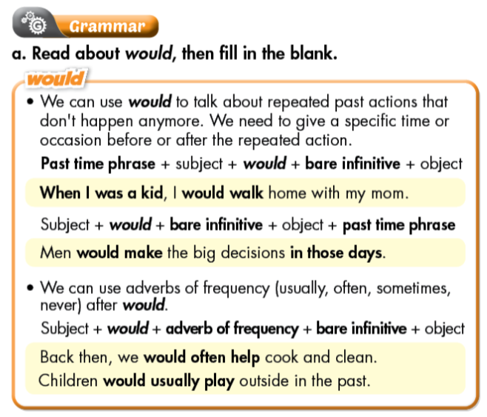
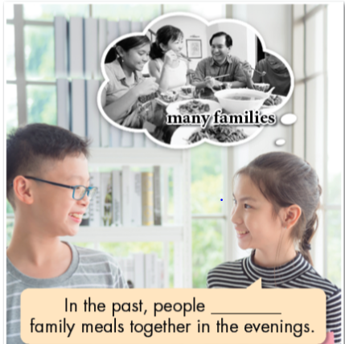
Listen and check. Listen again and repeat.
would eat

Slide 9
Unscramble the sentences.
1.family meals./In the past,/for/people/be home/would usually
2. people/five to ten/have/Back then,/would/ usually/ children.
3. in extended families./Fifty years ago,/people/live/would often
4. the husband/be/A hundred years ago,/the breadwinner./would often
5. Back then,/after getting married./women/would become/ housewives
6. the whole family./cook for/the mother/In the past,/would
In the past, people would usually be home for family meals.
Back then, people would usually have five to ten children.
Fifty years ago, people would often live in extended families.
A hundred years ago, the husband would often be the breadwinner.
Back then, women would become housewives after getting married.
In the past, the mother would cook for the whole family.

Slide 10
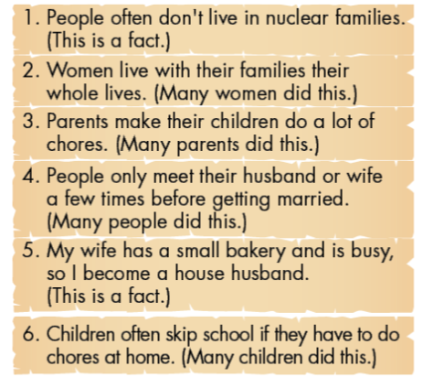
D. Read the statements about life in the past and complete the sentences below using would or the Past Simple.
1.In the past, people often didn't live in nuclear families.
2.In the past, women would live with their families their whole lives.
3.Parents would make their children do a lot of chores back then.
4.People would only meet their husband or wife a few times before getting married in the past.
5.Back then, my wife had a small bakery and was busy, so I became a house husband.
6. Back then, children would often skip school if they had to do chores at home.

Slide 11
Share your ideas about life in the past with a partner
1. In the past, people often didn't live in nuclear families.
2. In the past, ______________________________________.
3. _________________________________________ back then.
4. _________________________________________ in the past.
5. Back then, _________________________________________.
6. Back then, _________________________________________.

Slide 12
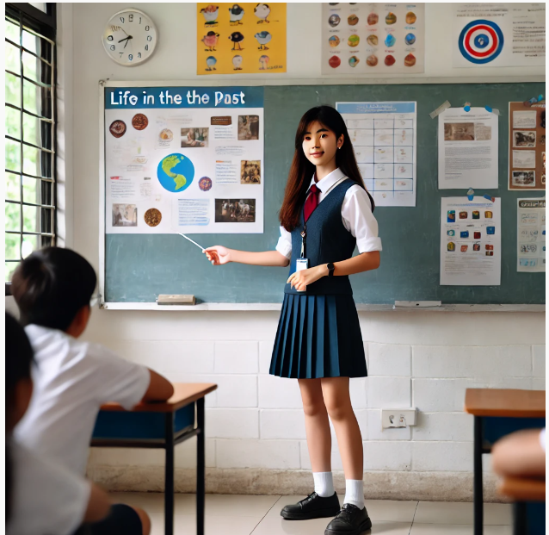
Student A : "In the past, families were larger and often lived together in extended families. I think this was good because it created strong family bonds."
Student B: "I agree. However, I also think it might have been challenging to have so many people living together. Today, families are smaller, which can make things simpler and more manageable."

Slide 13
e. In pairs: Use the topics below to talk about things that happened regularly when you were a kid.
Topics
going to school
at school
after school
on the weekends
on holidays
in the summer

Slide 14
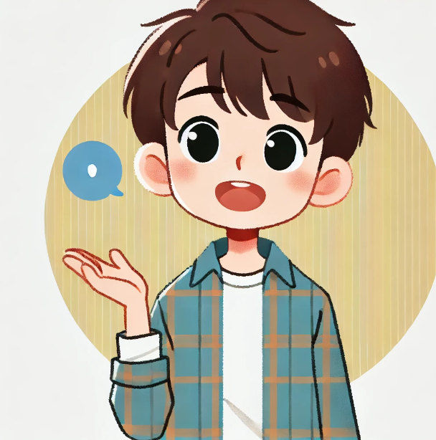
Going to School
"My dad would drive me to school every day."
"I would walk to school with my friends every morning."
"We would stop at a bakery on the way to school."

Slide 15
At School
"During recess, I would play soccer with my classmates."
"I would always sit in the front row in the classroom."
"Our teacher would read us a story every Friday afternoon."

Slide 16
After School
"I would go to my grandparents' house after school."
"My mom would help me with my homework."
"We would have a snack and watch cartoons after school."

Slide 17
On the Weekends
"Every Saturday, my family would go to the park for a picnic."
"I would visit my cousins and play games with them."
"We would go to the cinema every Sunday afternoon."

Slide 18
On Holidays
"We would visit my grandparents in the countryside during holidays."
"Every Christmas, we would decorate the tree together."
"I would go to the beach with my family on summer holidays."

Slide 19
In the Summer
"In the summer, we would often go swimming in the lake."
"I would attend a summer camp with my friends."
"We would have barbecues in the backyard every weekend."

Slide 20
WRAP-UP
Unit 2
LIFE IN THE PAST
Lesson 2: GRAMMAR
Ms Phương
Zalo: 0966765064
Grammar:
Practice and use “would” for repeated past actions.
Speaking:
Talk about things that happened regularly when they were kids.

Slide 21
HOMEWORK
1. Review “would” for repeated past actions .
2. Make sentences using “would”
3. Prepare for the next lesson (Pronunciation & Speaking - pages 16 & 17 - SB).

