Slide 1
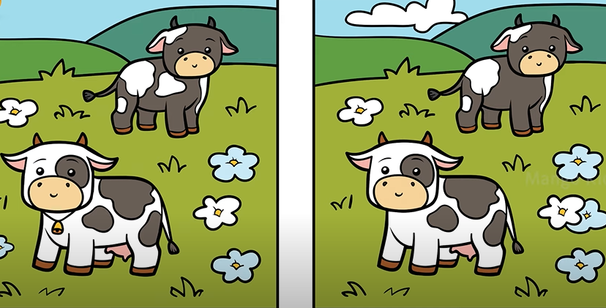
Picture A is _______________ picture B
different from
a. the same
b. different from

Slide 2
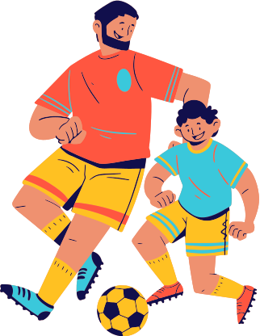
_____his father, Peter enjoys playing football.
Like
b. like
a. as

Slide 3
Unit 8: Festivals around the World
Lesson 2.2: Grammar
Page 64

Slide 4
A/ Grammar
“different from” and “like”
Ex: Like American children, French children go hunting on Easter Sunday.
- Like + N: giống ai/ cái gì……
Usage: We use like + noun to say that two things are similar.

Slide 5
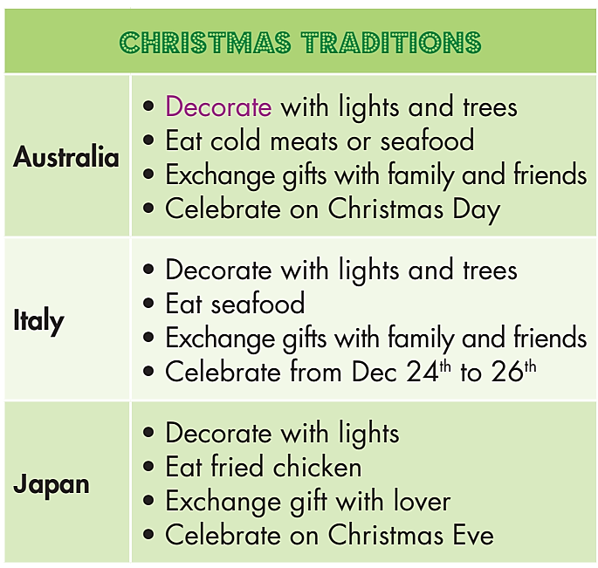
Ex: In Italy, they eat seafood at Christmas. That’s different from Japan.
- be + different from : khác biệt với….ai/ cái gì
Usage: We use be + different from to say that one thing is not the same as another or other items.

Slide 6
a. Listen and repeat

Slide 7
b. Unscramble the sentences.
1.dessert/from/different/is/Japan's./Christmas/Germany's ___________________________________________________________
2. Brazil's/costume/Years/is/from/different/Vietnam's./New ___________________________________________________________
3. Vietnamese/Koreans/visit/Like/people,/temples.
____________________________________________________________
4. Australians,/gifts/Americans/Like/exchange/Christmas./at
_____________________________________________________________
Halloween/in/from/Halloween/the/in/different/is/Mexico./US
______________________________________________________________
6. children/Like/French/children,/Easter./chocolate/at/English/get/eggs
______________________________________________________________
Germany’s Christmas dessert is different from Japan’s.
Brazil’s New Years costume is different from Vietnam’s.
Like Vietnamese people, Koreans visit temples.
Like Australians, Americans exchange gifts at Christmas.
Halloween in the US is different from Halloween in Mexico.
Like French children, English children get chocolate eggs at Easter.

Slide 8
c. Write sentences using the table.
1. Italians decorate ________________________ Australians. 2. Christmas meal in Japan _________________ __________________________ Italy. 3. Australians exchange ____________________. That's ___________ Japanese people. 4. Italy celebrates Christmas from ____________. _______________________________ Australia. 5. Italians exchange _______________________. _________ Australians. 6. Australia celebrates Christmas on __________. That's __________Japan. 7. Christmas meal in Italy __________________ _________________________ Australia.
with lights and trees. That’s like
is different from Christmas meal in
gifts with family and friends
different from
December 24th to 26th . That’s different from
gifts with family and friends.
That’s like
Christmas Day
different from
is different from Christmas meal in

Slide 9
d. In pairs: Compare Christmas traditions in your country with one of the countries in the table in Task c.
CHRISTMAS
Australia | My country - Vietnam
• Decorate with lights and trees • Eat cold meats or seafood • Celebrate on Christmas Day • Exchange gifts with family and friends

Slide 10
d. In pairs: Compare Christmas traditions in your country with one of the countries in the table in Task c.
On Christmas day, my country decorate with lights and trees. That’s like Australia.
We eat traditional meals with family. That’s different from Australia.
CHRISTMAS
Australia | My country - Vietnam
• Decorate with lights and trees • Eat cold meats or seafood • Celebrate on Christmas Day • Exchange gifts with family and friends | Decorate with lights and trees eat traditional meals with family People and couples go downtown Children wear Christmas costume. Christian celebrate Christmas in churches and decorate homes with lights and trees.

Slide 11
Unit 8: FESTIVAL AROUND THE WORLD
Lesson 5: Grammar
- be + different from : Ai, cái gì khác biệt với….ai, cái gì.
Like + nouns: Giống ai, cái gì……
Learn about differences in Christmas celebration in different countries.
Ms Phương
Zalo: 0966765064

Slide 12
HOMEWORK
Make 2 sentences using “different from” and “like”.
- Do the exercises in WB: Grammar & Writing (page 47).
- Prepare: Lesson 2.3 – Pronunciation and Speaking (page 65 – SB).

