Slide 1
WARM UP
Work in pair. Find the mistake and correct in each sentence.
Let’s going to the zoo tonight.
How about have a barbecue in the garden?
Why don’t we buying this dress?
I think we should goes to the cinema.
Would you like drinking some tea?
go
Ms Phương
Zalo: 0966765064
having
buy
go
drink

Slide 2
Unit 4: Community Services
Lesson 1.3: Pronunciation & Speaking
Page 30

Slide 3
Let’s watch the video.

Slide 4
1/ Pronunciation.
bake sale

Slide 6
Work in pairs, matching the events to the appropriate activities.
Events | Activities
Car wash | Sell paintings
Fun run | Make cupcakes
Bake sale | Sell comics
Craft fair | Wash cars
Book fair | Sell tickets
Art show | Make cards
Talent show | Sell drinks

Slide 7
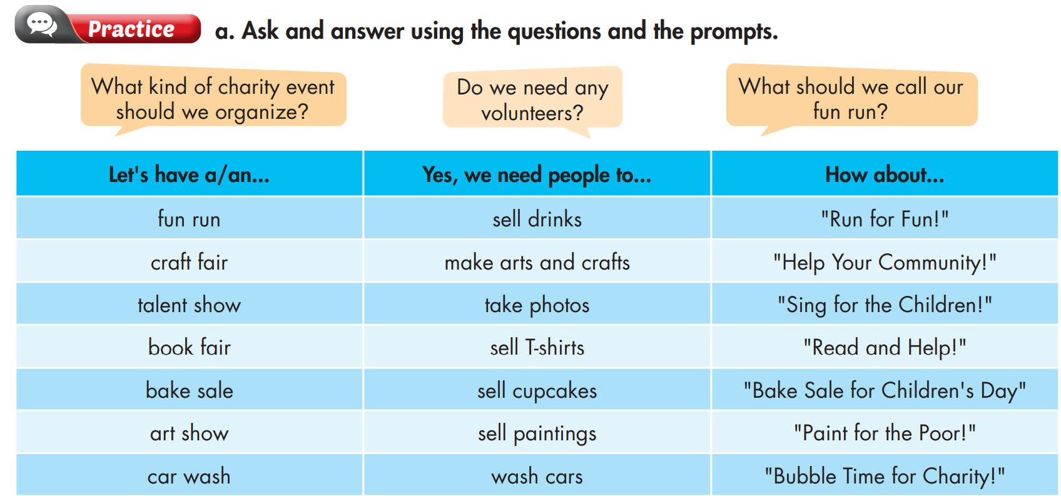
2/ Practice

Slide 8
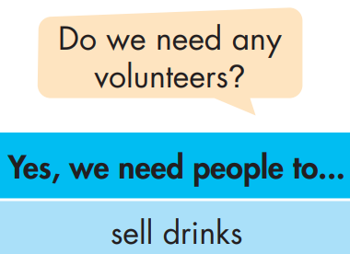
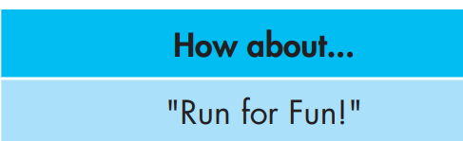
Example
What kind of charity event should we organize?
Do we need any volunteers?
What should we call our Fun run?
Let's have a Fun run
Yes, we need people to sell drink.
How about “ Run for fun”?

Slide 9
What kind of charity event should we organize?
Do the same
Fun Run | Sell drinks | “Run for Fun”
Craft Fair | Make arts and crafts | “Help your Community”
Talent Show | Take photos | “Sing for the Children”
Book Fair | Sell T-shirts | “Read and Help”
Bake Sale | Sell cupcakes | “Bake Sale for Children Day”
Art Show | Sell paintings | “Pain for the Poor!”
Car Wash | Wash cars | “Bubble Time for Charity”
Let's have a Craft Fair.
Do we need any volunteers?
Yes, we need people to make arts and crafts.
What should we call our Craft Fair?
How about “ Help your Community”?

Slide 10
What kind of charity event should we organize?
Do the same
Fun Run | Sell drinks | “Run for Fun”
Craft Fair | Make arts and crafts | “Help your Community”
Talent Show | Take photos | “Sing for the Children”
Book Fair | Sell T-shirts | “Read and Help”
Bake Sale | Sell cupcakes | “Bake Sale for Children Day”
Art Show | Sell paintings | “Pain for the Poor!”
Car Wash | Wash cars | “Bubble Time for Charity”
Let's have a Talent Show.
Do we need any volunteers?
Yes, we need people to take photos.
What should we call our Talent Show?
How about “Sing for the Children”?

Slide 11
Ask your partner using the prompts and then practice with your own idea.
Fun Run | Sell drinks | “Run for Fun”
Craft Fair | Make arts and crafts | “Help your Community”
Talent Show | Take photos | “Sing for the Children”
Book Fair | Sell T-shirts | “Read and Help”
Bake Sale | Sell cupcakes | “Bake Sale for Children Day”
Art Show | Sell paintings | “Pain for the Poor!”
Car Wash | Wash cars | “Bubble Time for Charity”

Slide 12
What kind of charity event should we organize?
Do the same
Fun Run | Sell drinks | “Run for Fun”
Craft Fair | Make arts and crafts | “Help your Community”
Talent Show | Take photos | “Sing for the Children”
Book Fair | Sell T-shirts | “Read and Help”
Bake Sale | Sell cupcakes | “Bake Sale for Children Day”
Art Show | Sell paintings | “Pain for the Poor!”
Car Wash | Wash cars | “Bubble Time for Charity”
Let's have a Book Fair.
Do we need any volunteers?
Yes, we need people to sell T-shirts.
What should we call our Book Fair?
How about “Read and Help”?

Slide 13
What kind of charity event should we organize?
Let's have a …
Do we need any volunteers?
Yes, we need people to …
What should we call our …?
How about …?

Slide 14
Charity event

Slide 15
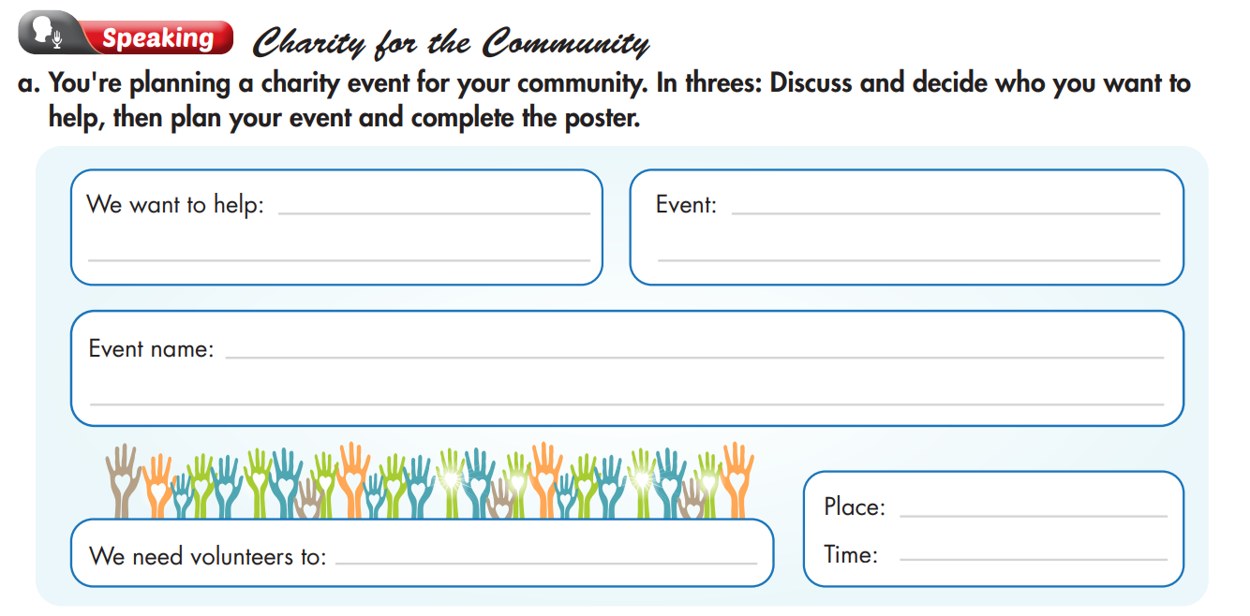
3/ Speaking

Slide 16
Who should we help?
I think we should help the poor students in our school.
poor students in our school

Slide 17
What do you think we should do to help?
Let’s have a Food Fair.
Food Fair

Slide 18
What should we call our Food Fair?
How about “Eat and Help”?
Eat and Help

Slide 19
Do we need volunteers?
Yes, we need people to cook and sell food.
cook and sell food

Slide 20
Where and when should we have the event?
I think we should have the event in our schoolyard next weekend.
schoolyard
next weekend

Slide 21
I think we should help the poor students in our school.
Who should we help?
We want to help:
the poor students in our school.
I think we should a Food Fair.
What do you think we should do to help?
Event:
a Food Fair.
What should we call our a Food Fair?
Event name:
“Eat and Help”?
How about “Eat and Help”?
Yes, we need some people to cook and sell food
We need volunteers to : cook and sell food
Do we need any volunteers?
Where and when should we have the event?
I think we should have the event in our schoolyard next weekend
Place: in our schoolyard
Time: next weekend

Slide 22
We are going to have a Food Fair to raise money for the poor students in our school. Our event name is “Eat and Help”, so you can come to enjoy delicious food and help your friends. We also need volunteers to cook and sell food at the event. Please join us to make it successful. The event will happen in our schoolyard next weekend. Hope to see you there.

Slide 23
Unit 4: COMMUNITY SERVICE
Lesson 3: Pronunciation + Speaking
Ms Phương
Zalo: 0966765064
Pronunciation: stress of compound nouns.
Speaking:
talk about how to organize a charity event.
practice pronouncing compound nouns.

Slide 24
HOMEWORK
Practice pronouncing compound nouns.
Redo the writing exercise on page 21 WB.
Prepare the next lesson (page 31 SB).
Review all the vocabularies and grammar in the unit.

