Slide 1
WARM UP
WARM UP

Slide 2
The teacher say some sentences. If the sentence is correct, student put the thumb nail, if the sentence is incorrect, the students say “ ố ồ”
1. We would like to drink a orange juice , please
2. I don’t have any eggs left.
3. We drinks a lot of milks for breakfast every day.
4. Sorry! There aren’t some water left.
5. Would you like some chicken pasta?

Slide 3
Unit 5: Around Town
Lesson 1.3: Pronunciation & Speaking
Page 40

Slide 4
PRONUNCIATION
Listen. Notice the sound changes of the underlined words. Do you have these pants in blue? Do you have this jacket in green?
/ ʤə hæv /

Slide 5
I/ Pronunciation.
a/ “Do you have.......?” often sound like / ʤə hæv /
Do you have these pants in blue? Do you have this jacket in green?

Slide 6
b. Listen and cross out the one with the wrong sound changes.
Do you have these sockes in red?
Do you have this shirt in pink?

Slide 7
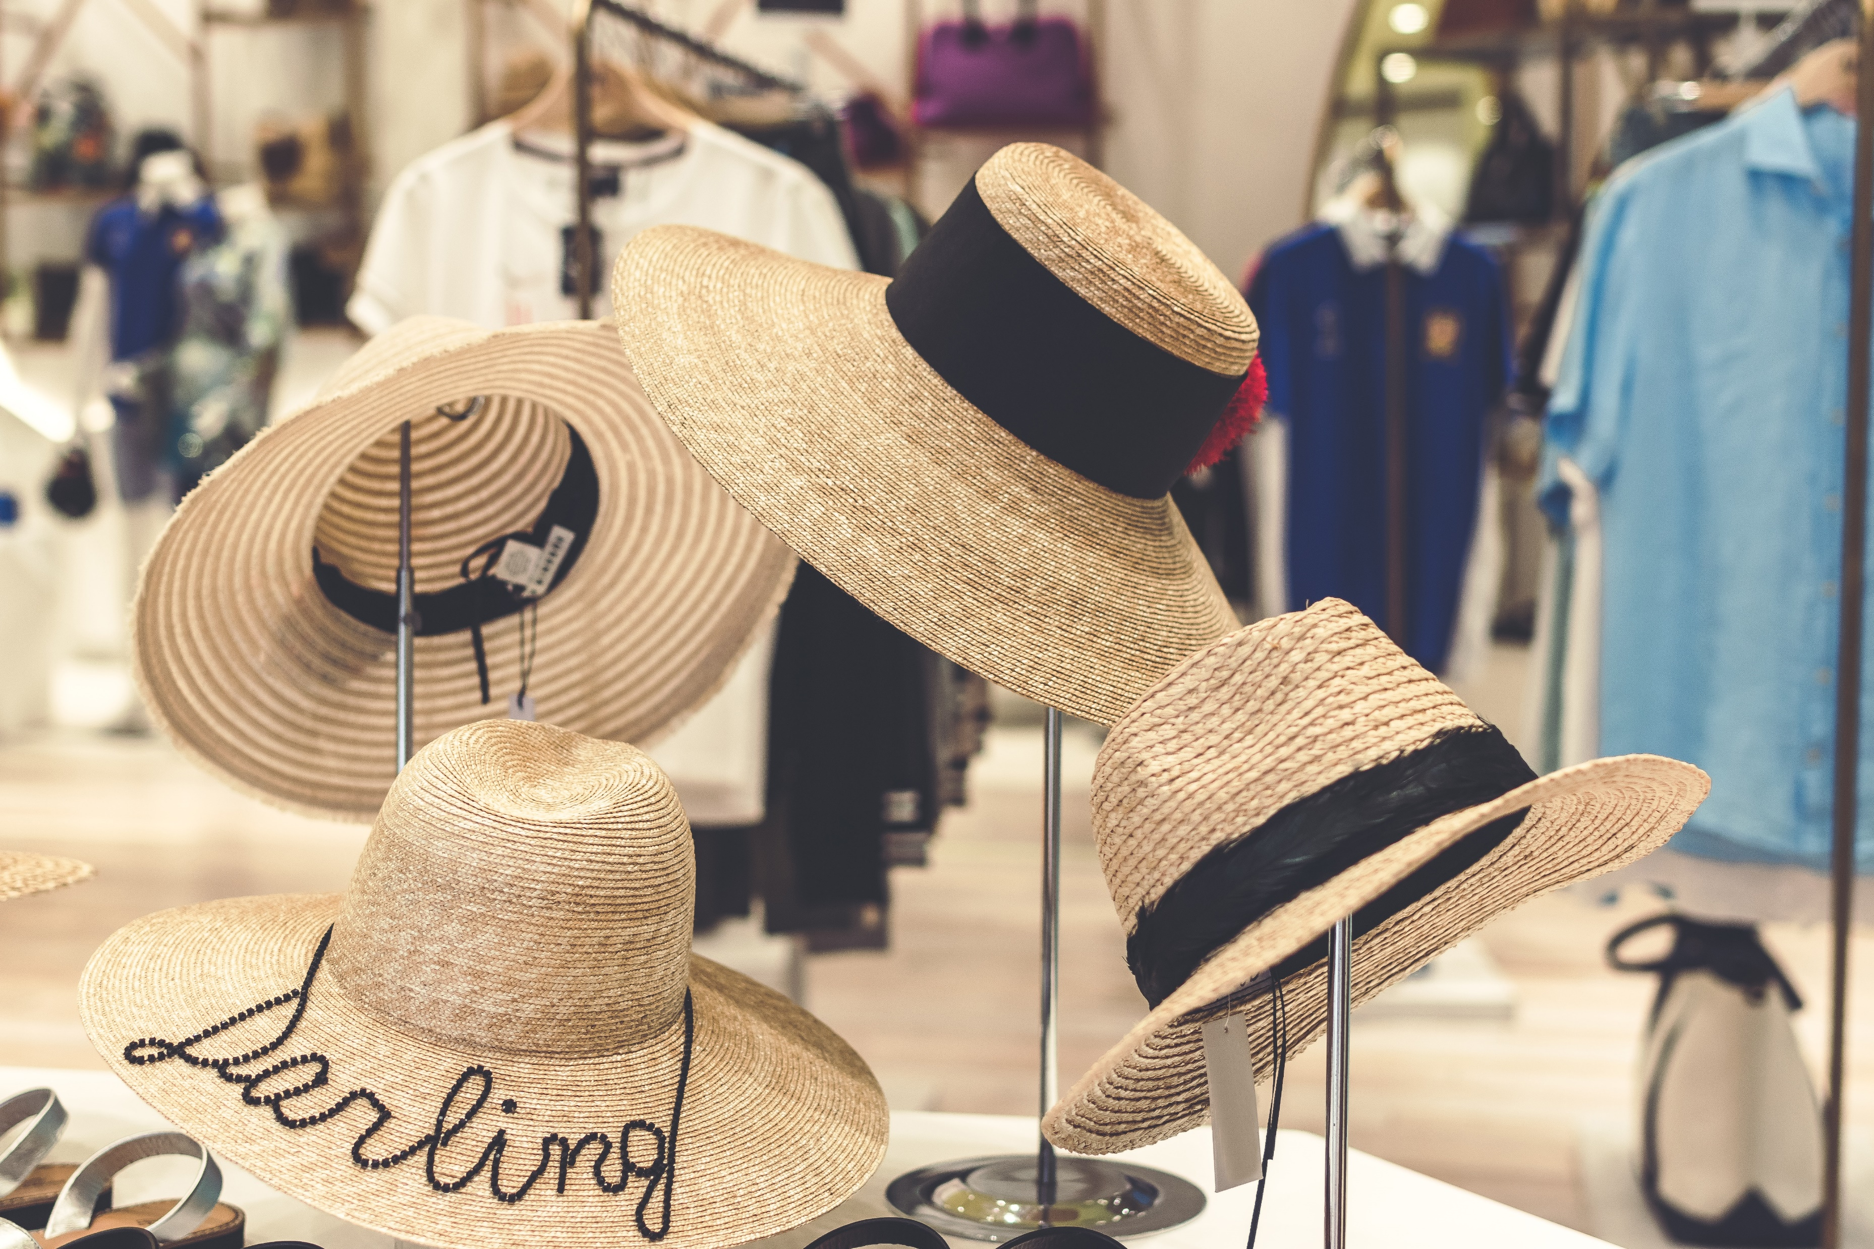
II/ Practice
a/ Practice the conversation. Swap roles and repeat.
Sales assistant : Hi, can I help you?
Customer: Yes, do you have this shirt in blue?
Sales assistant: Yes, here you are.
Customer: Do you have it in a medium size?
Sales assistant: Yes, here you are.
Customer: Can I try it on?/
Sales assistant: Yes, the changing room’s over there.
(Later...)
Sale assistant: Is it ok?
Customer: Yes, how much is it?
Sale assistant: It’s 20 dollars.
Practice the conversation. Swap roles and repeat.

Slide 8
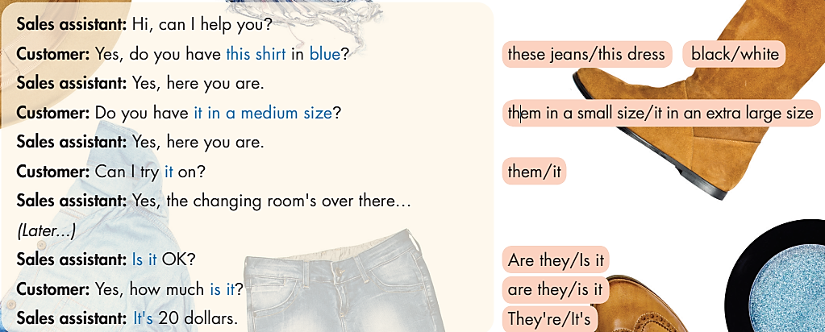
II/ Practice
a/ Practice the conversation. Swap roles and repeat.
Practice the conversation. Swap roles and repeat.
b/ Practice with your own ideas.

Slide 9
III/ Speaking

Slide 10
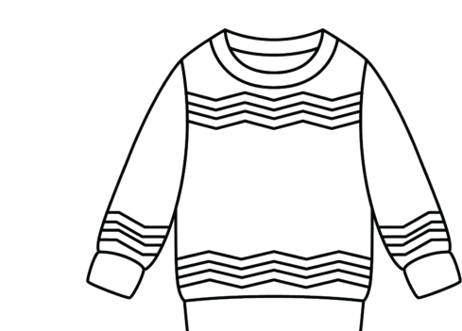
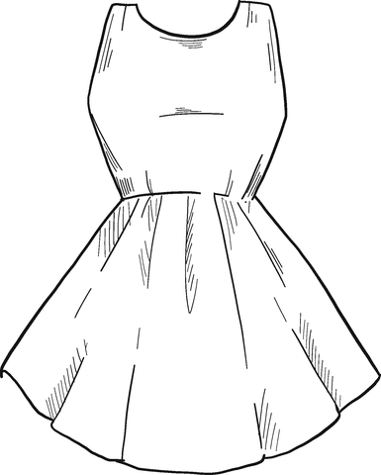
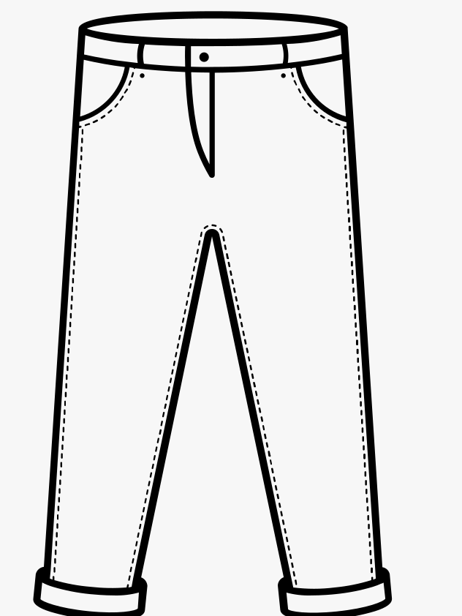
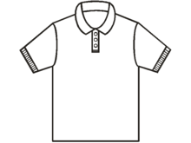
Sweater
Dress
jeans
shirt

Slide 11
III/ speaking
clothes shopping
STUDENT A
a. You are shopping for clothes . Work in pairs. Student B p121. File 4. Student A, you’re a customer. Choose three items below and note the size and color you want. Ask the sales assistant
________________
________________
________________
________________

Slide 12
Sales assistant : Hi, can I help you?
Customer: Yes, do you have this shirt in blue?
Sales assistant: Yes, here you are.
Customer: Do you have it in a medium size?
Sales assistant: Yes, here you are.
Customer: Can I try it on?
Sales assistant: Yes, the changing room’s over there.
(Later...)
Sale assistant: Is it ok?
Customer: Yes, how much is it?
Sale assistant: It’s 20 dollars.

Slide 13
b/ In groups, discuss the items you bought and how much you spent.
I bought (a/an) ………in (a/an) …………. size, (a/an) …………..in (a/an) …………..…. size, and (a/an) ………….in (a/an) ………….…. size. I spent ………… dollars in total.

Slide 14
WRAP-UP
* Pronunciation: “Do you have …?” often sounds like /dʒə hӕv/
* Some useful languages
Can I help you?
Here you are
Try it on

Slide 15
HOMEWORK
- Practice using sound changes in the question: “Do you have …?”
- Practice asking and answering about buying clothes.
- Prepare: Lesson 2: New Words and Reading (page 41 – SB).

Slide 16
III/ speaking
clothes shopping
STUDENT A
a. You are shopping for clothes . Work in pairs. Student B p121. File 4. Student A, you’re a customer. Choose three items below and note the size and color you want. Ask the sales assistant
________________
________________
________________
________________
Student B. You’re a sales assistant at a store. You have the clothes below.
Sweater
Price: $ 40
Sizes: S,M,XL
Color
Shirt
Price: $ 45
Sizes: S,M,L , XL
Color
Pants
Price: $ 35
Sizes: S,M,XL
Color
Dress
Price: $ 45
Sizes: S,M,L
Color
b/ In groups, discuss the items you bought and how much you spent.

