Slide 1
WARM-UP

Slide 2
Watch a video and say the activities that you hear.
1. What activities can you hear in the video?
Go shopping, make breakfast, do the laundry, take an art class, exercise, go to the movies, visit …parents, meet friends, go to a baseball game,…
2. Which tense do they use to make plans in the future?
present continuous

Slide 3
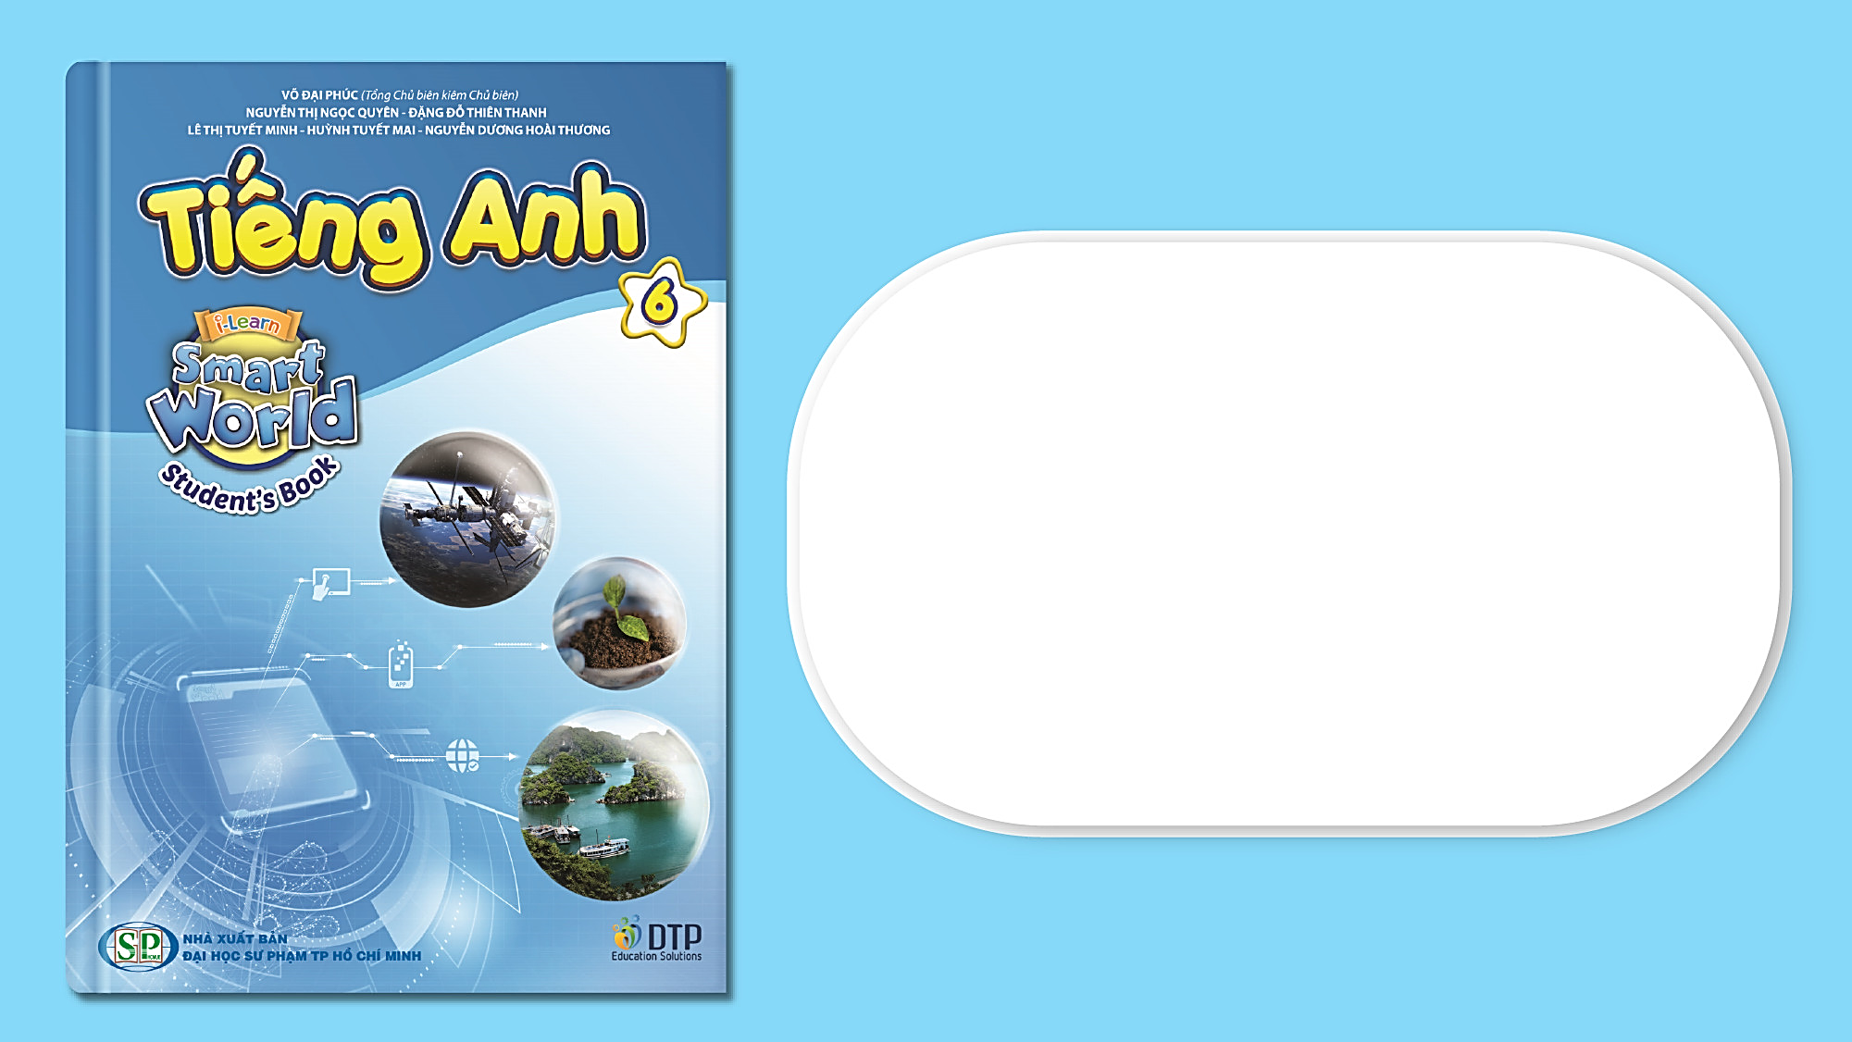
Unit 3: Friends
Lesson 2.2: Grammar
Page 26

Slide 4
1/ Grammar

Slide 5
1/ Grammar
Present continuous
Usage:
We can use the Present Continuous tense for fixed future plans
Thì hiện tại tiếp diễn có thể được sử dụng để nói về một kế hoạch đã định sẵn sẽ làm trong tương lai.
Note:
Tonight: tối nay
Tomorrow: ngày mai
Next week/…: tuần tới
This summer/… : mùa hè này
I am watching a movie tonight.
He is making a cake tomorrow.
We are visiting our grandparents next weekend.

Slide 6
Khẳng định: S + am/is/are + V-ing…
I am watching a movie tonight.
He is making a cake tomorrow.
They are playing soccer on the weekend.
Form:
Phủ định: S + am not /isn’t/aren’t + V-ing…
I am not watching a movie tonight.
He is not making a cake tomorrow.
They are not playing soccer on the weekend.
Câu hỏi: (Wh) Am/Is/Are + S+ V-ing?...
What are you doing tomorrow/next week?
Are you playing badminton tomorrow?
Is she making a cake tonight?

Slide 7
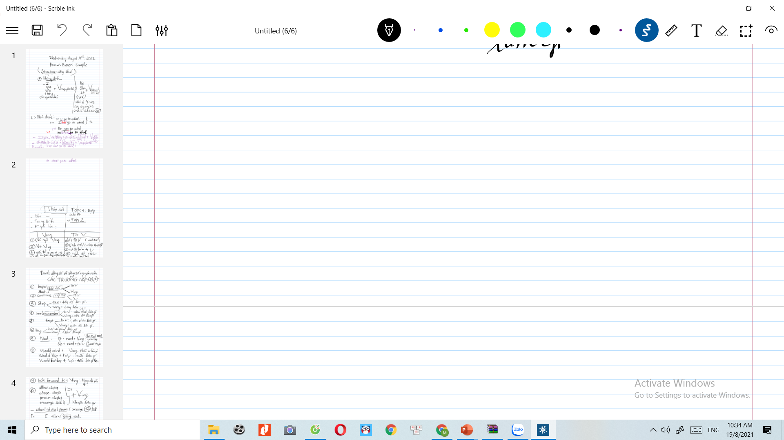
2/ PRACTICE
E.b/ Fill in the blanks using the Present Continuous.
1. My brother ______________________(go) shopping on Friday.
is going
2. What ______you (do)________________tomorrow?
are
doing
am making
3. I ________________(make) a pizza tomorrow.
4. ___________they (have) ______________a picnic in the park this weekend?
Are
having
5. She _________________(go) to the mall with Mark on Saturday.
is going
6. We ____________( play) basketball this evening.
are playing
7. ______________he _____________(watch) a movie at home tonight ?
Is
watching

Slide 8
E.c/ Write full sentences using the given words and the Present Continuous.
1. He/not/have a picnic/ this Saturday.
He isn’t having a picnic this Saturday.
2. I/ have a barbecue/ today.
I am having a barbecue today.
3. Emma and Jane / not watch a movie / on next Sunday.
Emma and Jane aren’t watching a movie next Sunday.
4. We / make a pizza/ this weekend.
We are making a pizza this weekend.
5. David / play/ badminton/this evening?
Is David playing badminton this evening?
6. Maria/watch TV/ with her sister/ tonight?
Is Maria is watching TV with her sister tonight?

Slide 9
E.d/ Now, write true sentences about yourself and then ask your partner.
am doing my homework
am having a picnic with my friends

Slide 10
HOMEWORK
MAKE A PLAN FOR YOUR WEEKEND USING PRESENT CONTINUOUS

