Slide 1

WELCOME
To Our Lesson
Teacher: Lê Thị Huỳnh Hà
Class: 9A3
School: Nguyễn Trường Tộ

Slide 2
Chatting:
- What is the song about?
- What is the song about?
- Do you love your father?
- What do you think about your father?

Slide 3
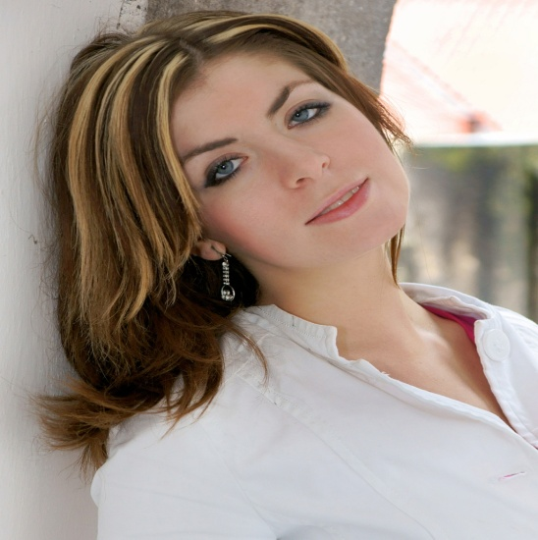
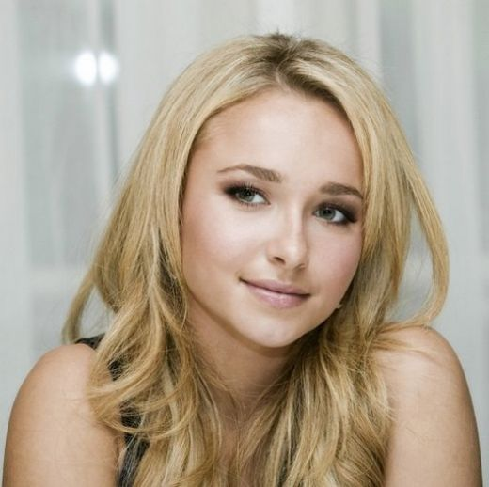
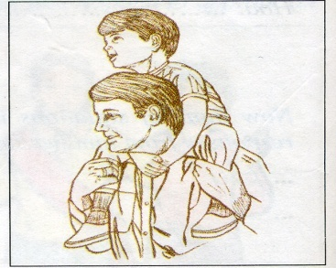
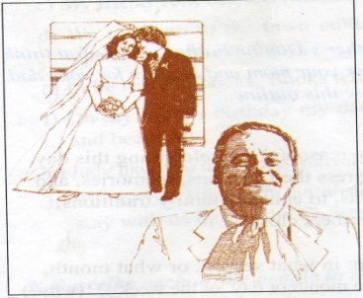
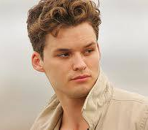
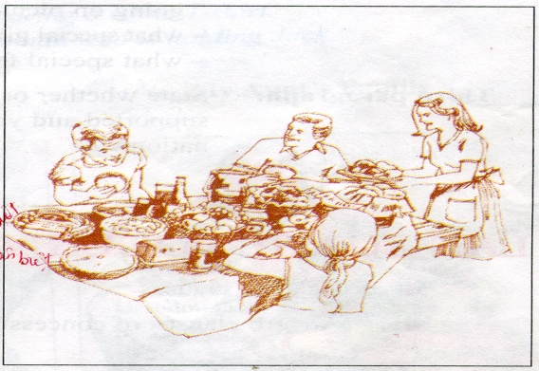
Rita (Australia)
Jane (USA)
Bob (Australia)

Slide 4

UNIT 8: CELEBRATIONS
Lesson 3: Read

Slide 5
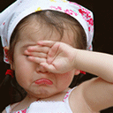
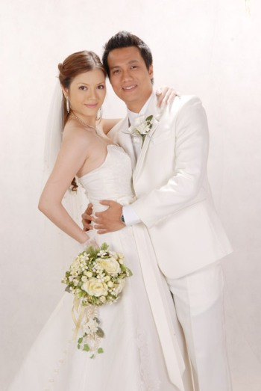
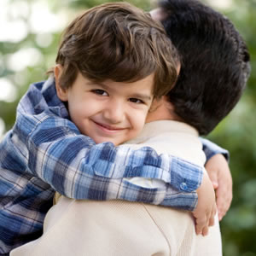

I.Vocabulary:
- tear ( n):
nước mắt
- lose heart ( v) :
nản lòng
- groom ( n):
chú rể
- hug ( n, v):
ôm
- considerate (a):
ân cần, chu đáo
- distinguish ( v):
phân biệt
- priority ( n) :
sự ưu tiên

Slide 6

What and where?
groom
priority
considerate
lose heart
hug
tear

Slide 7
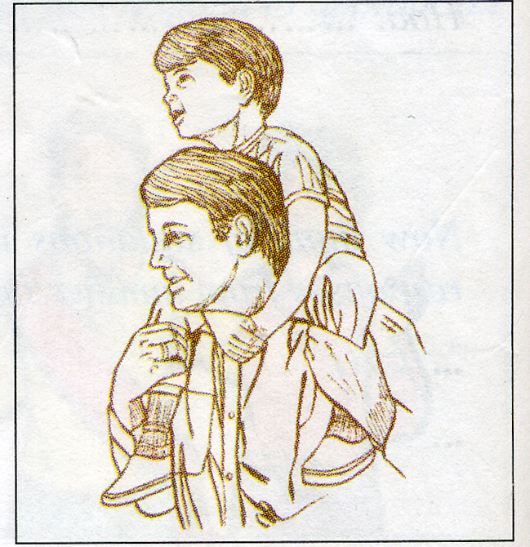
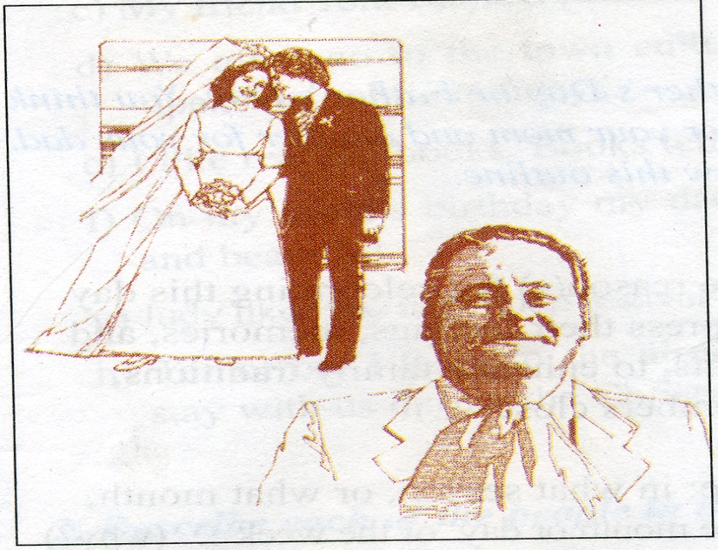

Rita( Australia)
Jane (USA)
Bob(Australia)

Slide 8
* Guess and then Match the fathers with the things that children write about them:
3, has sense of
humor
4, says never
lose heart
Rita’s
father
2, teaches his
children how
to cry and laugh
Bob’s
father
5, had tears in his
eyes on his child’s
wedding day
Jane’s
father
1, is missed
and loved
much
6, is considerate

Slide 9


II. Practice:
There are many occasions for you to express your feelings to others. Following are opinions, feelings and memories of children about their fathers on Father’s Day in Australia and the USA.

Slide 10
Rita (Australia)
To the one who teaches me how to love, cry and laugh.
To the one who says never lose heart and always finish what you start.
To the one whose feelings for me are so strong that the word love can't describe them.
Can you guess who it is?
It's not too hard to tell ...
Jane (USA)
Daddy, I am writing this to tell you how much you are missed and loved.I will always remember that day - my wedding day.You were standing there with tears in your eyes while I was walking towards my groom.You gave me a hug, and the feeling that you never wanted to let me go.But at last I had to leave you and start my new life ... a moment in time that lasted forever.I now have children, Dad, but I will always be your little girl!Happy Father's Day.
Bob (Australia)
You ask me what I think about my dad.Great! Great! I must tell you my dad is the best person in the world.Do you know what I mean?He is a considerate and generous man who is loved not only by his family but also by all his friends.His priority is always his family.His sense of humor distinguishes him from others.In a word, my dad's terrific!I'm so proud of him and love him so much.Happy Father's Day, Daddy!

Slide 11
1 Guess and then Match the fathers with the things that children write about them:
3, has sense of
humor
4, says never
lose heart
Rita’s
father
2, teaches his
children how
to cry and laugh
A Good
Father
Bob’s
father
5, had tears in his
eyes on his child’s
wedding day
Jane’s
father
1, is missed
and loved
much
6, is considerate

Slide 12
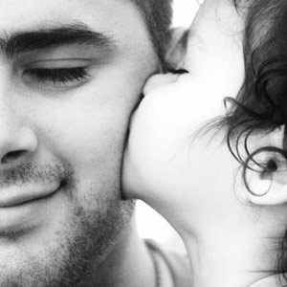
2. Answer the questions:
a. Who do you think Rita sends this card to?
b. Is Jane’s father alive or dead? How do you know this?
c. Which quality makes Bob’s father different from others?
I think Rita sends this card to her father.
He is possibly dead. These ideas may tell about that: “how much you are missed … I now have children, Dad …”
His sense of humor makes him different from others.
d. What image of a father can you draw from the three passages ?
A father can be a teacher, a caretaker and a friend.

Slide 13
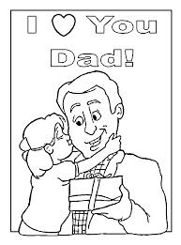

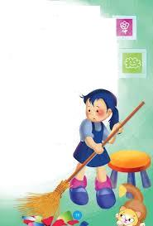
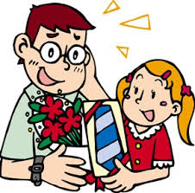

giving gifts
having a party
giving flowers
What do people do on Mother’s Day or Father’s Day?
Activities
on Mother’s Day or
Father’s Day
doing the
housework
sending cards

Slide 14



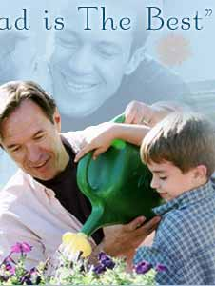

Slide 15
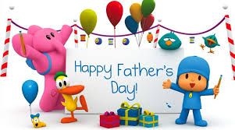
Homework
- Learn vocabulary by heart .
- Rewrite the answers in your exercise book.
- Prepare: Unit 8- Language Focus 1,2

Slide 16
Relative clauses
Ex1: Rita sends a card to her father. He teaches her how to love, cry and laugh
=> Rita sends a card to her father who teaches her how to love, cry and laugh.
Ex 2: Tet is a festival. The festival occurs in late January or early February.
=> Tet is a festival which occurs in late January or early February.

Slide 17

Thank You!

